Slide 1
Web 2.0pen Framework
A Revolution for Entrepreneurs, Inventors, and Organizations

Slide 2
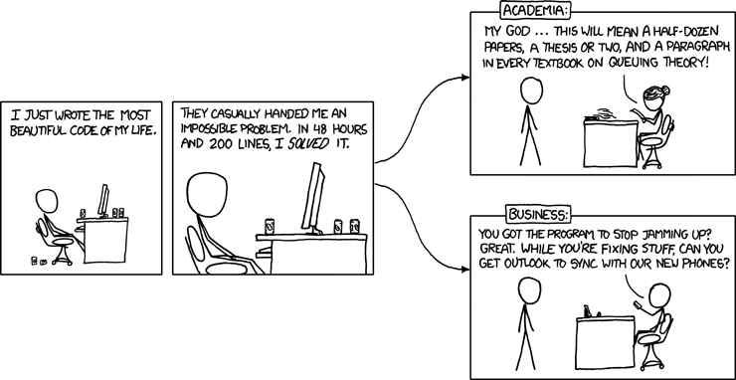
Intellectuals solve problems. Geniuses prevent them. – Albert Einstein

Slide 3
Why Not to Sleep During This
Information Technology changes have caused a sea change in low-cost, easy-to-use organizational workflows
If you believe information technology should be a net benefit in time and energy rather than a net loss, then… if it’s not, re-think what you’re doing.
The simultaneous need for both strict independence and privacy, along with opt-in capability for collaboration, has traditionally been a difficult problem.
Recent developments in online information technology make this a solvable problem.
SMOs couldn’t play this game before; now they can.

Slide 4
context
A Technology Meme Kit for Self-Protection

Slide 5
How the Tech Industry Works
A frog put in a pan with hot water will jump out. In a pan of gradually heated warm water, however, he boils to death.
The traditional SMB approach to information technology is the frog in the pan approach.
When the water is boiling, we (IT) sell you ice cubes.

Slide 6
The Technology Dance
Organizations/businesses deal with messy human problems; technologists need to reduce everything to networks, algorithms and data.
Organizations speak a language that “codes” the memes of the realm; information technologists speak the language of rigorous patterns. Who translates and how?
Those who keep a foot in both camps tend to do both poorly. Why? Because both information technology and business models move too fast for a person to keep up.

Slide 7
Technology Memes to Avoid
Arcade Model: InfoTech industry sets up to look easy and cheap and quick, but you have to keep putting quarters in the machine to play, and… uh …there’s only one game.
False KISS Model: Simple not the same as simplistic. 10% better design up-front renders 100% better return.
Magic Model: IT waves a magic wand and fully-loaded content appears in a site without any work by the stakeholders. Nothing of value is truly free.
Techno-therapy Model: The true objective is not a solution, but rather the joy of tinkering and brain-picking.

Slide 8
The Four Geeks of the Apocalypse
The four guys who can kill your SMO if you let them:
  Infrastructure (networks, communications, hardware)
  Data
  Software
  User Interface/Design
Mostly, they don’t know each other’s world
This means that when you choose an IT guy, he’s likely a specialist in one of those areas and faking the rest
Which means all your problems will look like a nail to his hammer. Avoid this if possible.

Slide 9
What’s coming?
Disruptive Information Technologies You Need to Know

Slide 10
Web 2.0:I-Tech Trends are E-Tech Trends
Enterprises are early adopters of disruptive technology; SMOs get the trickle-down.
These are the Web 2.0 SMB opportunities if you’re paying attention to the right things.
  Cloud
  Mobility
  Social Media
  Mashups
Why do you care? Because you’re competing with someone, somewhere for attention and dollars. They appear to have the same product or service you do, but who controls the perception, and which one gets found in the global haystack?

Slide 11
Roles Are Changing!
In corporate enterprises, information technology is becoming commoditized, like much else in society.
Chief Technology Officers (CTOs) are becoming Chief Process Officers (CPOs).
Infrastructure and data in the cloud allows low-cost solutions to be cobbled together (mashups).
Open-source is becoming slicker, better integrated and easier to implement and use.
For small operations, this means looking for someone who can understand your business model and find the framework that both fits your needs today and responds to future changes quickly and easily.

Slide 12
Business Drivers
Enterprise Requirements
Flexible
Fast
Cost-effective
User-centric
Technical Definition
Net-centric, net-aware
Multi-platform
Slim
Virtual

Slide 13
SMO Drivers
Accelerating change in business models
Adoption of disruptive technologies
Alignment between business model and technology
Alignment between future flexibility and flexible IT architecture
Reinforcement, reinforcement, reinforcement!
  (Think the Google search algorithms, think the viral media)
The Enterprise-SMO gap:
  Small footprint
  Affordable
  Instant
  Training-free

Slide 14
SMO Impact: Marketing & Advertising
Changes the way we reach and influence consumers
  Advertising has always been the least credible form of communications
  But we made up for it with scale
  Challenged by word-of-mouth
    The most credible form of communications
    Now with scale and targeting
Social
  We are influenced by peers and like-minded people
Mobile
  At the point of decision
Cloud
  With access to complete information
Credit: Jonathan Yarmis, Ovum

Slide 15
SMO Impact: Knowledge Management
One of the prime examples of technology overpromise and underdeliver
  It failed as a top-down, pre-structured initiative
Social
  We share information freely
Mobile
  Wherever we happen to be
Cloud
  With a robust back-end architecture
Credit: Jonathan Yarmis, Ovum

Slide 16
SMO Impact: CRM
Perhaps even more of a disappointment than KM
  We’ve spent more and gotten less
Social
  Who do we need to know and how do we get to them
Mobile
  Wherever I happen to be
  JIT
Cloud
  With access to full public and private information
Credit: Jonathan Yarmis, Ovum

Slide 17
SMO Impact: Collaboration
Finally, moving beyond email
Social
  Self-identifying groups
  “Ambient awareness”
Mobile
  At the point of creation and consumption
Cloud
  Global scale
Credit: Jonathan Yarmis, Ovum

Slide 18
SMO Impact: Business Intelligence
The explosion of data creation
  What happens when you can’t store it all
Social
  User-generated content
  Facebook users upload 80 million pictures a day
Mobile
  Location-based information
Cloud
  Getting it from the edge to the core
  Or processing it on the edge
Credit: Jonathan Yarmis, Ovum

Slide 19
SMO Impact: Reputation Mgmt
The new speed of business
Social
  Your brand is what your customers say it is
Mobile
  Instant complaint
  Resolution or firestorm
Cloud
  Instant distribution
  And it never goes away
Credit: Jonathan Yarmis, Ovum

Slide 20
Cloud
Advantages of the cloud
  Zero deployment
  Click-to-run
  Economies of scale
  Efficiency
Security is a red herring
It’s all about the economics

Slide 21
Cloud and the *aaS Model
Definition: “Unlocalized” or “anonymous” computing services and/or resources paid for by usage
Breaks down into loose types:
  SaaS - Software as a Service (SalesForce, Workday, Constant Contact)
  PaaS - Platform as a Service ( AppEngine, Hiroku)
  TaaS - Tools as a Service (SimpleDB, AMZN SQS)
  IaaS - Infrastructure as a Service (Amazon EC2, Hadoop)

Slide 22
So What’s Wrong with SaaS?
Where’s your data (information)?
Who owns your data (information)?
Why are you paying THEM when their business model is to make money off of YOU?
SaaS businesses run on the arcade model.
Constant Contact, Salesforce, Workday, etc. are fine, but it’s a slippery slope (Reinforcement, change???).
DON’T FORGET: The power of your framework is in
  Alignment
  Reinforcement

Slide 23
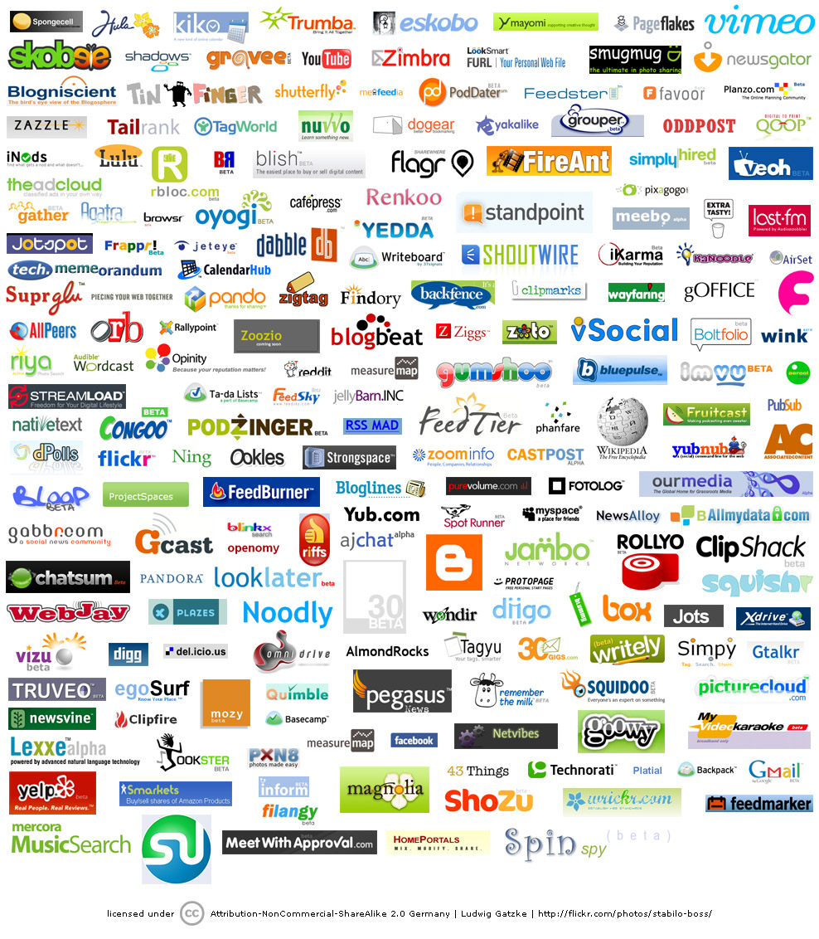
Social Media

Slide 24
Social Media
Used for:
  Crowd-sourcing
  Crowd-funding
  Viral marketing
  Customer service
  Prospecting
  Recruitment
  Customer retention
  Reputation management

Slide 25
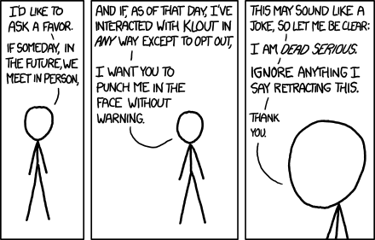
Social Media Encroachment
Credit: Randall Munroe, XKCD.com

Slide 26
It’s Not Really About Social Media
We’re really talking getting and retaining prospects, members, customers, investors
Social Media is just ONE piece of that puzzle
SEO and page rank used to be the big fad – so what happened?
Answer to all past and future questions –
  Reinforcement, reinforcement, reinforcement (round-trip approach)
Integrate all your socials, videos, syndications, e-newsletters, data, SEF, metadata, content, and documents.
How? You’d better have a modern, powerful platform to do that. Choose wisely.

Slide 27
Mobility
The platform for the next generation and emerging markets
Always with you
Knows where you are, who you know, what you’re doing
Time-zone independent
Is your site mobile? Do you know what that means?

Slide 28
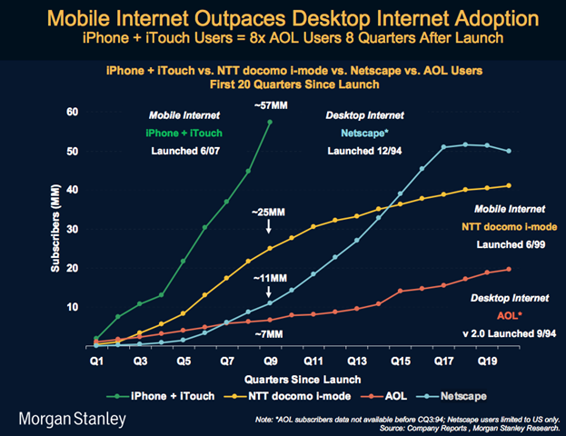
Mobility

Slide 29
Current IT-User Relationship
Flexibility
End Users
(e.g. Excel “apps”)
IT
(scalable, maintainable, secure)
Reliability
Time-to-market

Slide 30
Mashups Are the New Relationship Model
Reliability
End Users
(e.g. Excel “apps”)
IT
(scalable, maintainable, secure)
Flexibility

Slide 31
The Threshold Problem
SMO technology must be “small-footprint”:
  Affordable
  Learning and use time must net to the bottom line (IT is an non- CAPEX investment, not a depreciated sunk cost)
  Dumb-to-be-smart rather than smart-to-be-dumb
  Self-maintainable
  Mobile and 24/7 available
The evolution of technology can now meet this standard, bringing greater equality to the SMO ability to control the message and operations, and to get the message out.

Slide 32
Web2.open … Now!?
Compelling Benefits and Your Role

Slide 33
Web 2.Open – What Is It?
A framework for implementing disruptive technologies
SMO-affordable
SMO-maintainable
Scalable
Secure and robust
Flexible and extensible
Supportive community in lieu of paid support

Slide 34
Web 2.Open – What’s “In the Box”?
Free software under GPL2 or Creative Commons Licenses
A shared hosting service or Virtual Private Server (VPS)
CPanel or Plesk for Mail, DB, Security, Services, etc.
LAMP stack (Linux-Apache-MySQL-PHP) or WAMP stack
A CMS such as Joomla, Drupal, or Wordpress
YouTube, Vimeo, Facebook, Linked-In, Twitter accounts
Google Apps integrated (optional)
Previously-useful utilities such as Filezilla (FTP) or Photoshop are now often uneccessary

Slide 35
Web 2.Open – Why Care?
If you’re not collaborating, you’re losing the game. Today, you need to have available 24/7 collaboration (whether or not you choose to use it).
The website is no longer just a pretty face – it’s now ready for a Nobel Prize
You can’t afford the time, money, or energy to manage the workflows the “old” way. Your opportunity cost has risen while you weren’t paying attention!

Slide 36
Person versus Community
Your personal productivity may be a function of using tools you’re familiar with, as much as the power of the tool
A community, or SMO for our purposes, has a different dynamic. It is not an extension of your desktop or favorite technology.
If personal email, HTML websites, and spreadsheets are running an SMO, “productivity” loss is killing it softly (but surely). Re-purpose your time and energy.
Productivity is defined as the sum of abatable overhead + increased risk of missing objectives. These are under-estimated in almost all instances.

Slide 37
What Does Web2.0pen Deliver
Better recruiting
Membership control
Branding
Viral marketing
Event management
Combined person-organization planning (iCal, Skype, Twitter, etc.)
Reputation control
Investor credibility
Overhead re-purposed to core tasks

Slide 38
Path to enlightenment
Information Technology Weed-whacking

Slide 39
The 6-Step Intervention Process
Self-monitor your true objectives
Understand some basic IT principles and memes
Review the alternatives for alignment and cost
Understand your chosen framework and how it amplifies the achievement of your objectives
Budget separately for the framework versus the content
  Combining the two will cost you a huge premium
Don’t underestimate the cost time-energy cost of your non-technology commitment. Better a small, professional-looking, single-function site than a half-baked site.

Slide 40
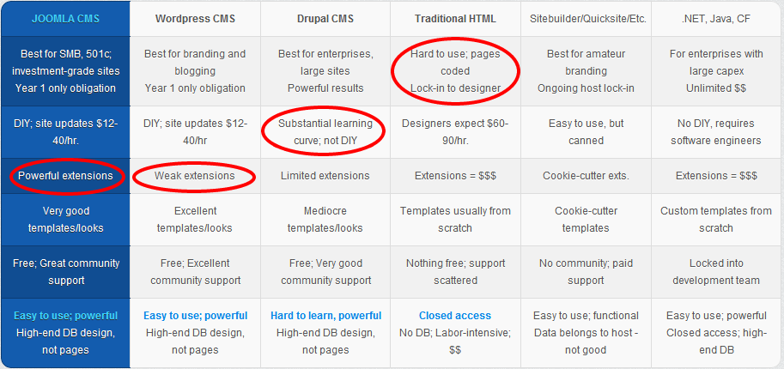
Todays SMO Framework Choices
Social Marketing is the new television advertising

Slide 41
Who Do You Trust?
If they keep talking hammer, then they’ll make your business model look like a nail.
Simplistic, incremental development (a la old-school HTML sites by artistes and wannabe programmers) are no longer affordable.
Site development today is really software development without the necessity of writing code. Ha!!!
And you can get all the pseudo-technical goodies without the pain of programming.

Slide 42
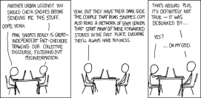
Who Do You Trust?

Slide 43
Under the Covers
HTML5 – superseding proprietary Adobe standards
PHP 5.4 – Lots of support for OOP, XML/XSL, SOs, DOs
MySQL evolving
Javascript (Mootools, Jquery)
OpenSource SMTP, POP3, IMAP
Integration with Google Apps doable – Google Location and Google Maps everywhere, iCal between Apple, Google, and Outlook, Google Translate, custom search, Analytics, etc.
Unflagging support from IBM; support from Oracle and others

Slide 44
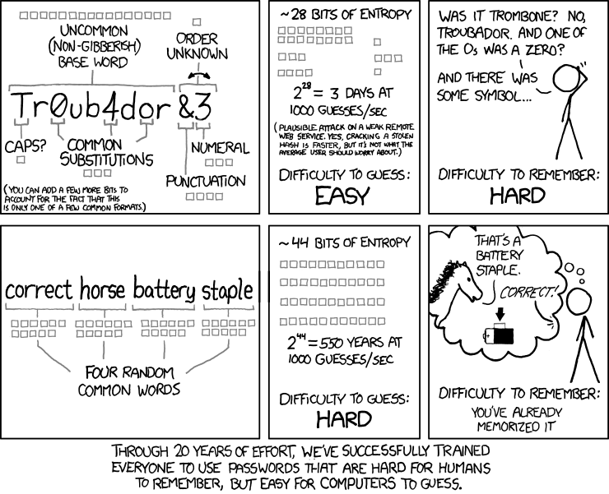
What About Security?

Slide 45
Case study
ReSET – A Specialized Social Enterprise Spawns SocialEC

Slide 46
Genesis
The Walker Group is a successful Connecticut technology consulting business
Kate Emery, the founder and CEO, wanted a business model that would guarantee in perpetuity the social mission of the company while not impacting the bottom line
She formed a non-profit 501(c)(3) to own the special class of voting stock that controls the “second bottom line” - ReSET
ReSET (Social Enterprise Trust), hosted a multi-regional group of like-minded social entrepreneurs from 24 countries
Witnessing this pioneering concept, these social entrpreneurs wanted to form an “instant community” that was 24/7, collaborative, had permission levels, interactive, and mobile

Slide 47
Requirements
Immediacy to grasp the opportunity window
Ease of use threshold for technophobe access
Multi-regional collaboration on document and content management
Self-managing directory to share organization info
Round-trip social media to for self-reinforcing Linked-in, Facebook, Twitter, RSS
Robust permissioning for secure group access to documents and data
Automated e-newsletters for ease of use and more effective use of email

Slide 48
Solution – SocialEC.com
Hosting, domain and site up within a day
CMS system needs only a simple login
CMS extensions provide no-cost org directory
Connections to social media easily linked
Permissioning can be applied in real time with working group
Forums and e-newsletters far superior to individual emails
Centralized document management for collaborative workflow
Google Maps and Google Places fully integrated

Slide 49
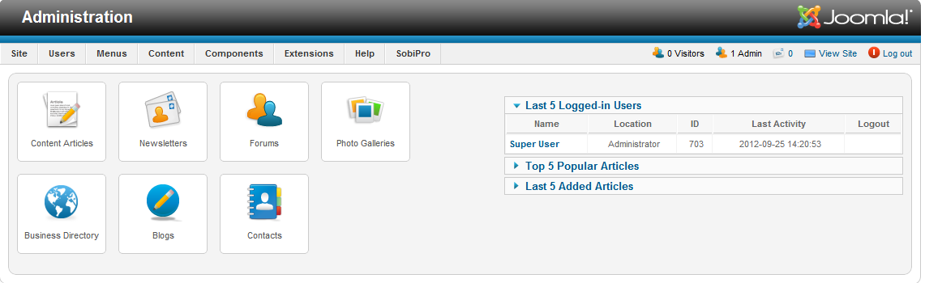
Administration Ease of Use

Slide 50
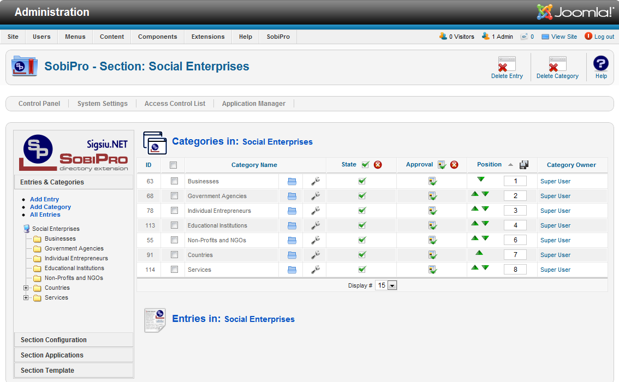
Business Directory (Back End)

Slide 51
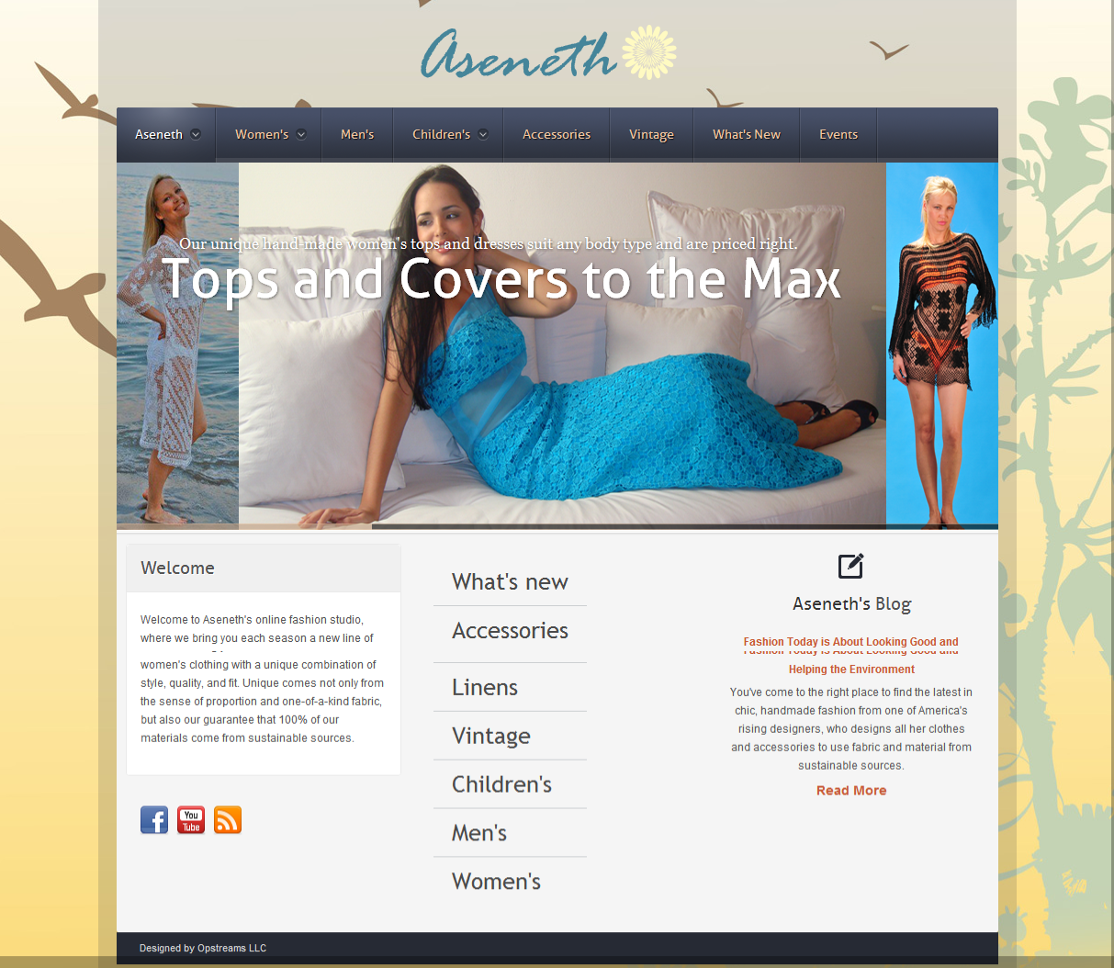
From Simple Indentity & E-commerce…

Slide 52
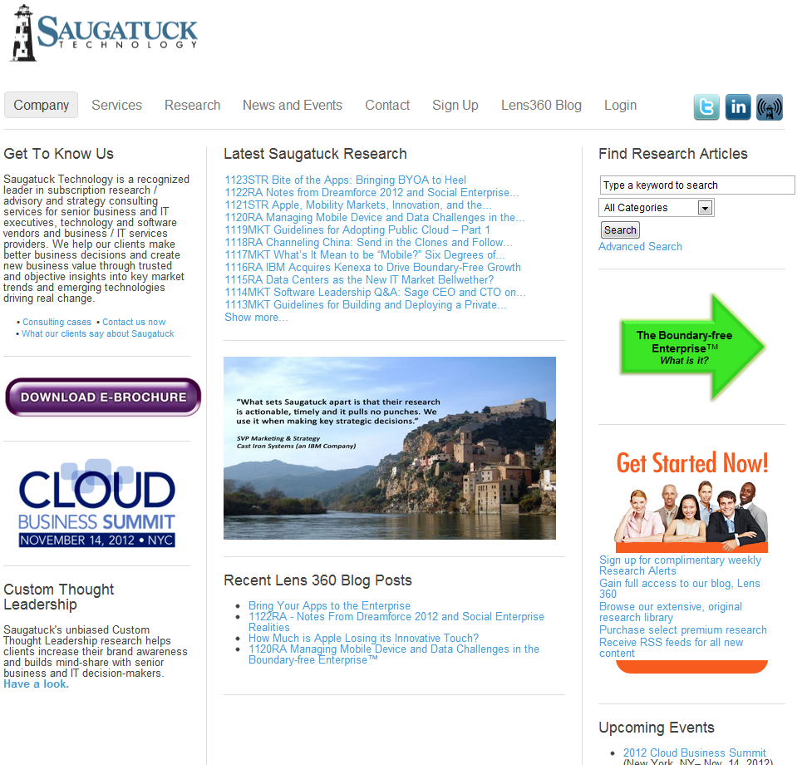
…To a Site Managing 95,000 Clients

Slide 53
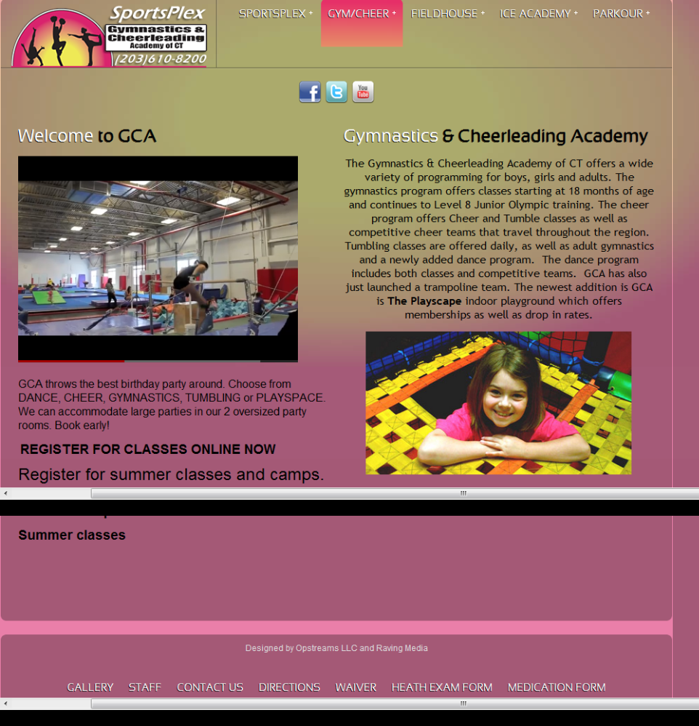
…To A Complex of 17 Facilities

Slide 54
All with one framework
THANK YOU!

